Slide 1
Data Types, Variables, and
Arrays
August 6, 2009

Slide 2
Java Is a Strongly Typed Language
  Every variable has a type, every expression has a type, and every type is strictly defined
  All assignments, whether explicit or via parameter passing in method calls, are checked for type compatibility
  The Java compiler checks all expressions and parameters to ensure that the types are compatible
August 6, 2009

Slide 3
The Simple Types
Java defines eight simple (or elemental) types of data: byte, short, int, long, char, float, double, and boolean
August 6, 2009

Slide 4
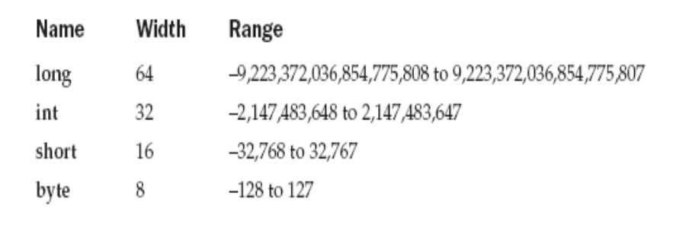
Integers
August 6, 2009

Slide 5
class Light {
public static void main(String args[]) {
int lightspeed; long days;
long seconds; long distance;
// approximate speed of light in miles per second
lightspeed = 186000;
days = 1000; // specify number of days here
seconds = days * 24 * 60 * 60; // convert to seconds
distance = lightspeed * seconds; // compute distance
System.out.print("In " + days);
System.out.print(" days light will travel about ");
System.out.println(distance + " miles.");
} }
August 6, 2009

Slide 6
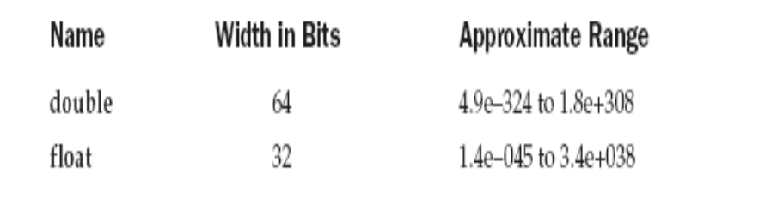
Floating-Point Types
August 6, 2009

Slide 7
class Area {
public static void main(String args[ ]) {
double pi, r, a;
r = 10.8; // radius of circle
pi = 3.1416; // pi, approximately
a = pi * r * r; // compute area
System.out.println("Area of circle is " + a);
}
}
August 6, 2009

Slide 8
Characters
  char in Java is not the same as char in C or C++.
  In C/C++, char is an integer type that is 8 bits wide
  Instead, Java uses Unicode to represent characters
  Unicode defines a fully international character set that can represent all of the characters found in all human languages
August 6, 2009

Slide 9
  In Java char is a 16-bit type
  The range of a char is 0 to 65,536
  There are no negative chars
August 6, 2009

Slide 10
class CharDemo
{
public static void main(String args[ ])
{
char ch1, ch2;
ch1 = 88; // code for X
ch2 = 'Y';
System.out.print("ch1 and ch2: ");
System.out.println(ch1 + " " + ch2);
}
}
August 6, 2009

Slide 11
class CharDemo2
{
public static void main(String args[ ])
{
char ch1;
ch1 = 'X';
System.out.println("ch1 contains " + ch1);
ch1++; // increment ch1
System.out.println("ch1 is now " + ch1);
}
}
August 6, 2009

Slide 12
Booleans
  Can have only one of two possible values, true or false
class BoolTest {
public static void main(String args[]) {
boolean b;
b = false;
System.out.println("b is " + b);
b = true;
August 6, 2009

Slide 13
System.out.println("b is " + b);
// a boolean value can control the if statement
if(b) System.out.println("This is executed.");
b = false;
if(b) System.out.println("This is not executed.");
// outcome of a relational operator is a boolean value
System.out.println("10 > 9 is " + (10 > 9));
}
}
The output generated by this program is shown here:
b is false
b is true
This is executed.
10 > 9 is true
August 6, 2009

Slide 14
  Integer Literals – Decimal, Hexa and Octal
  Floating-Point Literals
    For example, 2.0, 3.14159, and 0.6667 represent valid standard - notation floating-point numbers
    Scientific notation uses a standard-notation, floating-point number plus a suffix that specifies a power of 10 by which the number is to be multiplied eg. 6.022E23, 314159E–05, and 2e+100
  Floating-point literals in Java default to double precision. To specify a float literal, you must append an F or f to the constant.
August 6, 2009

Slide 15
  Boolean Literals – true , false
  Character Literals
    Characters in Java are indices into the Unicode character set
    They are 16-bit values that can be converted into integers and manipulated with the integer operators, such as the addition and subtraction operators
    - A literal character is represented inside a pair of single quotes
August 6, 2009

Slide 16
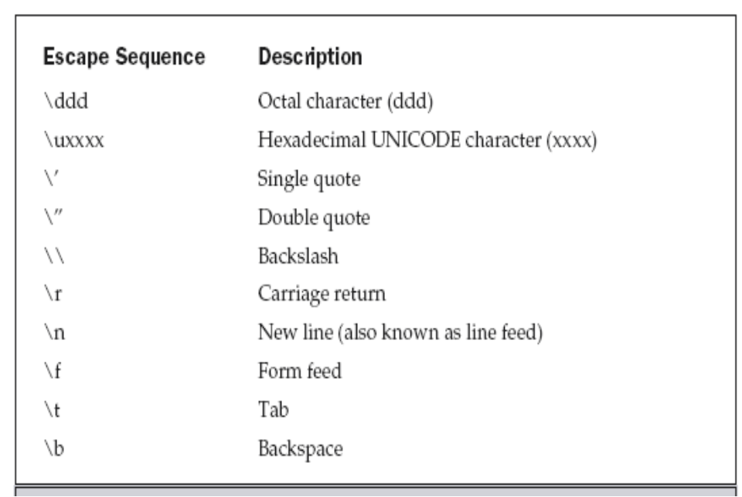
August 6, 2009

Slide 17
String Literals
  “Hello World”
  “two\nlines”
  “\”This is in quotes\””
August 6, 2009

Slide 18
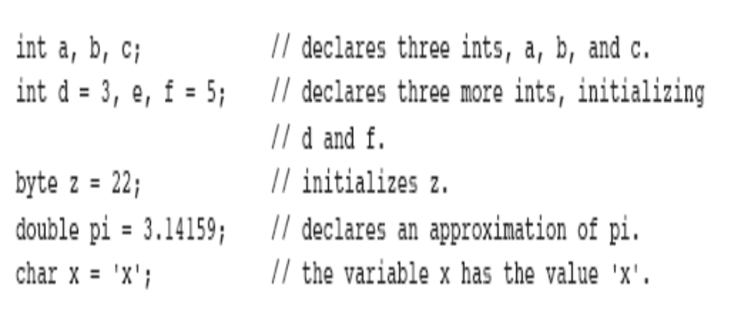
Declaring a Variable
type identifier [ = value][, identifier [= value] ...] ;
August 6, 2009

Slide 19
Dynamic Initialization
class DynInit {
public static void main(String args[]) {
double a = 3.0, b = 4.0;
// c is dynamically initialized
double c = Math.sqrt(a * a + b * b);
System.out.println("Hypotenuse is " + c);
}
}
August 6, 2009

Slide 20
The Scope and Lifetime of Variables
  Java allows variables to be declared within any block
  A block is begun with an opening curly brace and ended by a closing curly brace
  A block defines a scope
August 6, 2009

Slide 21
  In Java, the two major scopes are those defined by a class and those defined by a method
  As a general rule, variables declared inside a scope are not visible (that is, accessible) to code that is defined outside that scope
  Scopes can be nested
  Objects declared in the outer scope will be visible to code within the inner scope ; but reverse not true
August 6, 2009

Slide 22
class Scope {
public static void main (String args[]) {
int x; // known to all code within main
x = 10;
if(x == 10) { // start new scope
int y = 20; // known only to this block
// x and y both known here.
System.out.println("x and y: " + x + " " + y);
x = y * 2;
}
// y = 100; // Error! y not known here
// x is still known here.
System.out.println("x is " + x); } }
August 6, 2009

Slide 23
class LifeTime {
public static void main(String args[]) {
int x;
for(x = 0; x < 3; x++) {
int y = -1; // y is initialized each time block is entered
System.out.println("y is: " + y); // this always prints -1
y = 100;
System.out.println("y is now: " + y);
}
}
}
August 6, 2009

Slide 24
//This program will not compile
class ScopeErr {
public static void main(String args[]) {
int bar = 1;
{ // creates a new scope
int bar = 2; // Compile-time error – bar already defined!
}
}
}
August 6, 2009

Slide 25
Type Conversion and Casting
  When one type of data is assigned to another type of variable, an automatic type conversion will take place if the following two conditions are met:
■ The two types are compatible.
■ The destination type is larger than the source type.
  There are no automatic type conversions from int to char or boolean
August 6, 2009

Slide 26
Casting Incompatible Types
  what if you want to assign an int value to a byte variable?
  This conversion will not be performed automatically, because a byte is smaller than an int
  narrowing conversion – not automatic
August 6, 2009

Slide 27
A cast is an explicit type conversion, between incompatible types. General form is -
(target-type) value
  target-type specifies the desired type to convert the specified value to
      int a;
      byte b;
      // ...
      b = (byte) a;
August 6, 2009

Slide 28
class Conversion {
public static void main(String args[]) {
byte b;
int i = 257;
double d = 323.142;
System.out.println("\nConversion of int to byte.");
b = (byte) i;
System.out.println("i and b " + i + " " + b);
System.out.println("\nConversion of double to int.");
i = (int) d;
System.out.println("d and i " + d + " " + i);
System.out.println("\nConversion of double to byte.");
b = (byte) d;
System.out.println("d and b " + d + " " + b); } }
August 6, 2009

Slide 29
Output:
Conversion of int to byte.
i and b 257 1 ( b is i%256 )
Conversion of double to int.
d and i 323.142 323 (d is truncated to integer )
Conversion of double to byte.
d and b 323.142 67 ( fractional component is lost and %256 )
August 6, 2009

Slide 30
Automatic Type Promotion in Expressions
Example:
    byte a = 40;
    byte b = 50;
    byte c = 100;
    int d = a * b / c;
  Java automatically promotes each byte or short operand to int when evaluating an expression
August 6, 2009

Slide 31
  Subexpression a * b is performed using integer
byte b = 50
b = b * 2
// error: Cannot assign an int to a byte
In this case we need to explicitly specify:
byte b = 50;
b = (byte) (b*2);
August 6, 2009

Slide 32
The Type Promotion Rules
  All byte and short values are promoted to int
  If one operand is a long, the whole expression is promoted to long
  If one operand is a float, the entire expression is promoted to float
  If any of the operands is double, the result is double
August 6, 2009

Slide 33
class Promote {
public static void main(String args[ ]) {
byte b = 42;
char c = 'a';
short s = 1024;
int i = 50000;
float f = 5.67f;
double d = .1234;
double result = (f * b) + (i / c) - (d * s);
System.out.println((f * b) + " + " + (i / c) + " - " + (d * s));
System.out.println("result = " + result);
}
}
August 6, 2009

Slide 34
double result = (f * b) + (i / c) - (d * s);
  In the first sub expression, f * b, b is promoted to a float and the result of the sub expression
is float
  Next, in the sub expression i / c, c is promoted to int, and the result is of type int
  In d * s, the value of s is promoted to double, and the type of the sub expression is double
August 6, 2009

Slide 35
  The outcome of float plus an int is a float
  Then the resultant float minus the last double is promoted to double, which is the type for the final result of the expression
August 6, 2009

Slide 36
Arrays
  An array is a group of like-typed variables that are referred to by a common name
  A specific element in an array is accessed by its index
August 6, 2009

Slide 37
One-Dimensional Arrays
  type var-name[ ]; - No array exists
  array-var = new type[size]; - allocating memory
Example:
int month_days[] = new int[12]
August 6, 2009

Slide 38
  Arrays can be initialized when they are declared
  An array initializer is a list of comma-separated expressions surrounded by curly braces
  There is no need to use new
August 6, 2009

Slide 39
class AutoArray {
public static void main(String args[ ]) {
int month_days[] = { 31, 28, 31, 30, 31, 30, 31, 31, 30, 31,30, 31 };
System.out.println("April has " + month_days[3] + " days.");
}
}
August 6, 2009

Slide 40
class Average {
public static void main(String args[]) {
double nums[] = {10.1, 11.2, 12.3, 13.4, 14.5};
double result = 0;
int i;
for(i=0; i<5; i++)
result = result + nums[i];
System.out.println("Average is " + result / 5);
}
}
August 6, 2009

Slide 41
Multidimensional Arrays
  To declare a multidimensional array variable,
specify each additional index using another set of square brackets
Example:
int twoD[][] = new int[4][5];
August 6, 2009

Slide 42
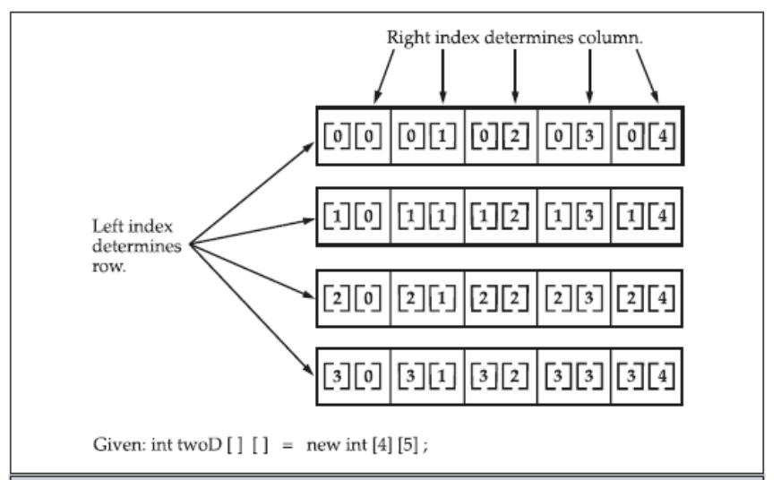
August 6, 2009

Slide 43
class TwoDArray {
public static void main(String args[]) {
int twoD[][]= new int[4][5];
int i, j, k = 0;
for(i=0; i<4; i++)
for(j=0; j<5; j++) {
twoD[i][j] = k;
k++;
}
for(i=0; i<4; i++) {
for(j=0; j<5; j++)
System.out.print(twoD[i][j] + " ");
System.out.println();
} } }
August 6, 2009

Slide 44
  When you allocate memory for a multidimensional array, you need only specify the memory for the first (leftmost) dimension
  You can allocate the remaining dimensions
separately
Example:
  int twoD[][] = new int[4][];
  twoD[0] = new int[5];
  twoD[1] = new int[5];
  twoD[2] = new int[5];
  twoD[3] = new int[5];
August 6, 2009

Slide 45
  When you allocate dimensions manually, you do not need to allocate the same number of elements for each dimension
  Since multidimensional arrays are actually arrays of arrays, the length of each array is under your control
August 6, 2009

Slide 46
class TwoDAgain {
public static void main(String args[]) {
int twoD[][] = new int[4][];
twoD[0] = new int[1]; twoD[1] = new int[2];
twoD[2] = new int[3]; twoD[3] = new int[4];
int i, j, k = 0;
for(i=0; i<4; i++)
for(j=0; j<i+1; j++) {
twoD[i][j] = k; k++; }
for(i=0; i<4; i++) {
for(j=0; j<i+1; j++)
System.out.print(twoD[i][j] + " ");
System.out.println(); } } }
August 6, 2009

Slide 47
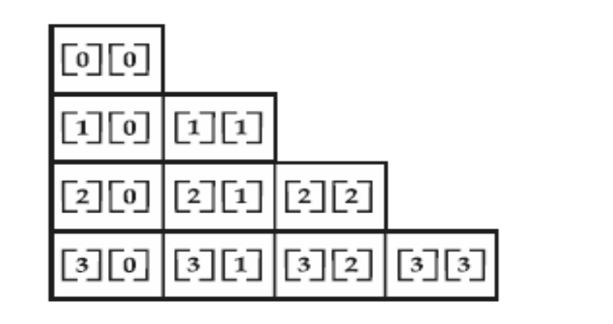
August 6, 2009

Slide 48
  It is possible to initialize multidimensional arrays
  You can use expressions as well as literal values inside of array initializers
August 6, 2009

Slide 49
class Matrix {
public static void main(String args[]) {
double m[ ][ ] = {
{ 0*0, 1*0, 2*0, 3*0 },
{ 0*1, 1*1, 2*1, 3*1 },
{ 0*2, 1*2, 2*2, 3*2 },
{ 0*3, 1*3, 2*3, 3*3 }
};
int i, j;
for(i=0; i<4; i++) {
for(j=0; j<4; j++)
System.out.print(m[i][j] + " ");
System.out.println(); } } }
August 6, 2009

Slide 50
Output:
  0.0 0.0 0.0 0.0
  0.0 1.0 2.0 3.0
  0.0 2.0 4.0 6.0
  0.0 3.0 6.0 9.0
August 6, 2009

Slide 51
Alternative Array Declaration Syntax
  There is a second form that may be used to declare an array:
type[ ] var-name;
Example: These two are equivalent
int al[ ] = new int[3];
int[ ] a2 = new int[3];
The following declarations are also equivalent:
char twod1[ ][ ] = new char[3][4];
char[ ][ ] twod2 = new char[3][4];
August 6, 2009

Slide 52
Note:
  Java does not support or allow pointers
  Java cannot allow pointers, because doing so would allow Java applets to breach the firewall between the Java execution environment and the host computer
  Java is designed in such a way that as long as you stay within the confines of the execution environment, you will never need to use a pointer, nor would there be any benefit in using one
August 6, 2009

